Slide 1
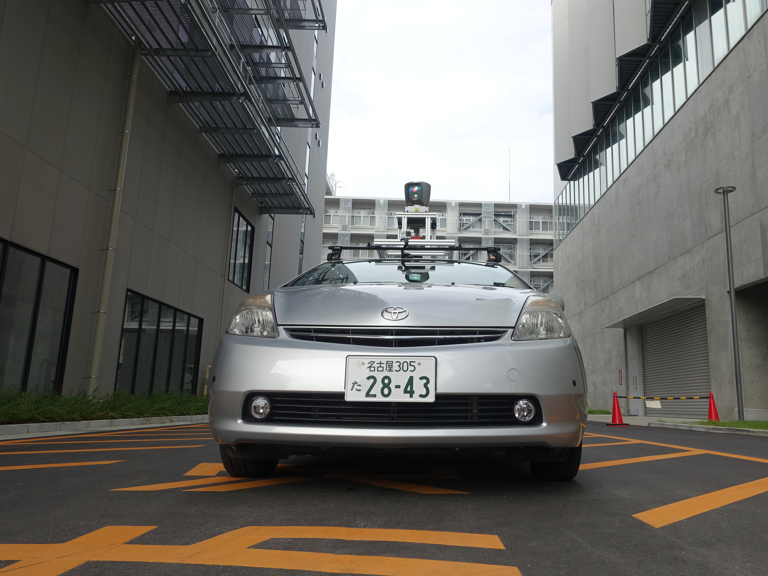
Autonomous Vehicle Plan Verification and Execution
Matthew O’Kelly Houssam Abbas Rahul Mangharam
University of Pennsylvania

Slide 2
Motivation

Slide 3
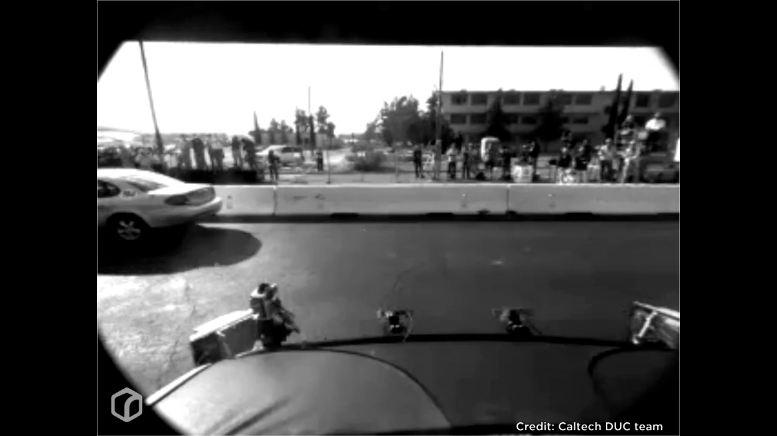
Motivation

Slide 4
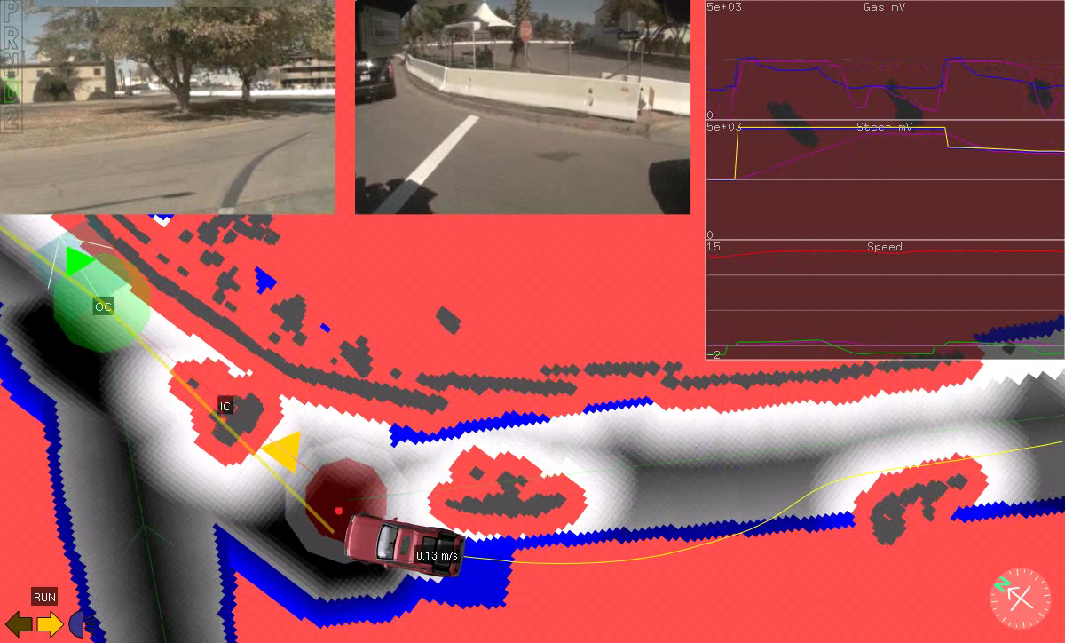

Slide 5
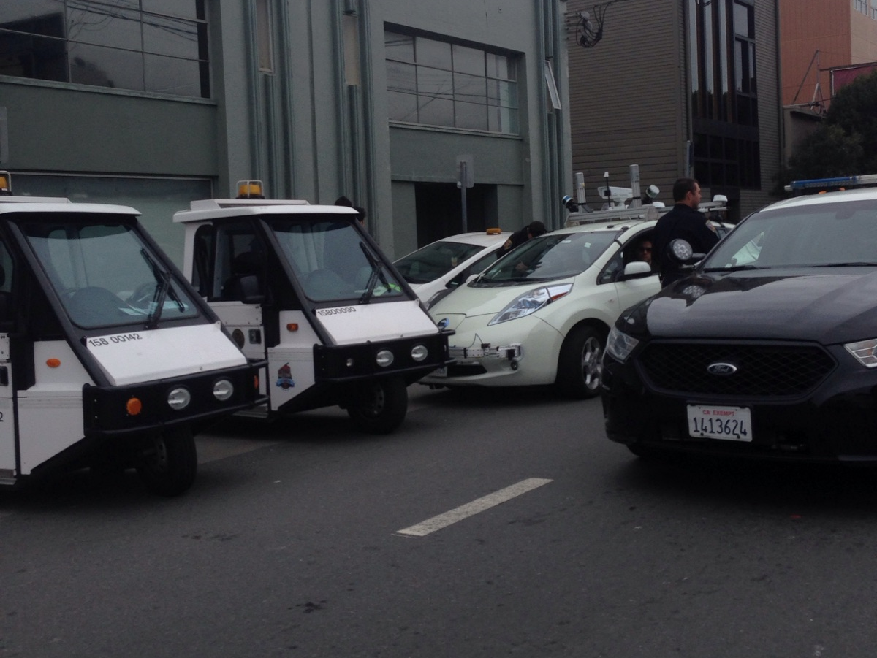
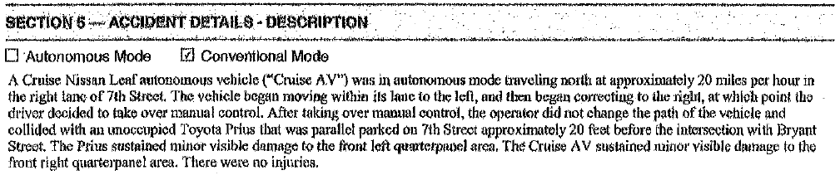

Slide 6
Summary

Slide 7
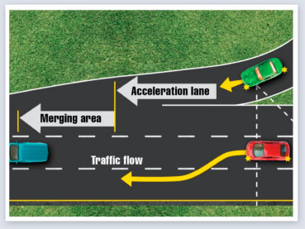
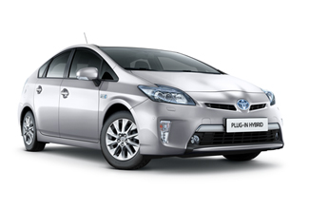
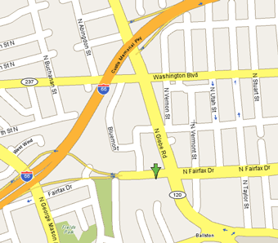

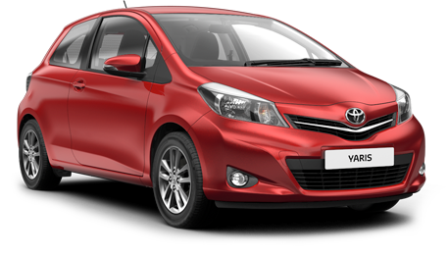


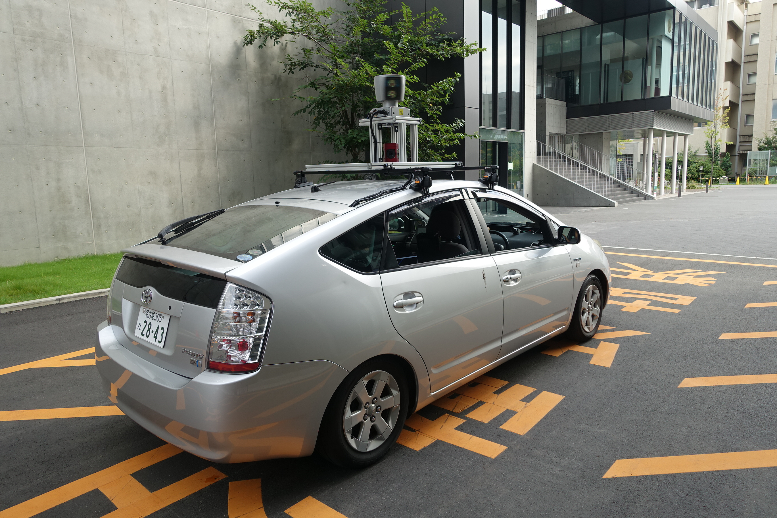
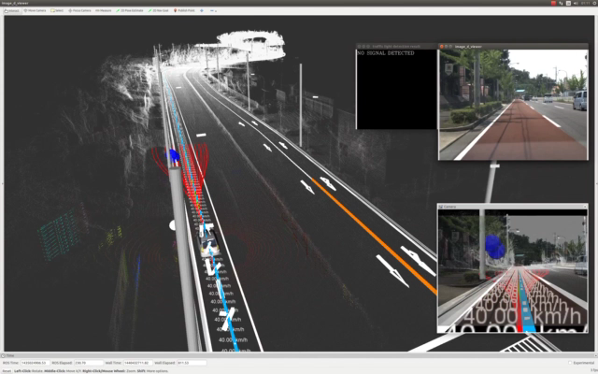
The APEX Approach
How can we provide a driver’s license for autonomous vehicles?
1
Explore the modeling of subsets of autonomous driving missions as scenarios
2
Map driving scenarios to collections of agents represented as hybrid systems
Driving Scenario
Target Vehicle
Road Network
Traffic Laws
Other Drivers
Pedestrians
Infrastructure
3
Implement state-lattice
planning stack in C++
Integrate ROS based vehicle OS
Validation of algorithms & software
4
5
Solution:
6
Reachability Problem
7
APEX automatically generates and solves a tree of reachability problems

Slide 8
Current Work
Development of AV model: Part 1
Development of hybrid systems framework and tool to accommodate AV model
Scenario 1: Lane Change
Development of AV model: Part 2
Scenario 2: Lane Change on Arbitrary Road
F1/10 Demo and Summary
Development of framework for scenario creation from Open Street Maps.
Support for AV model in Unity and Rviz.

Slide 9
Development of an AV Model

Slide 10
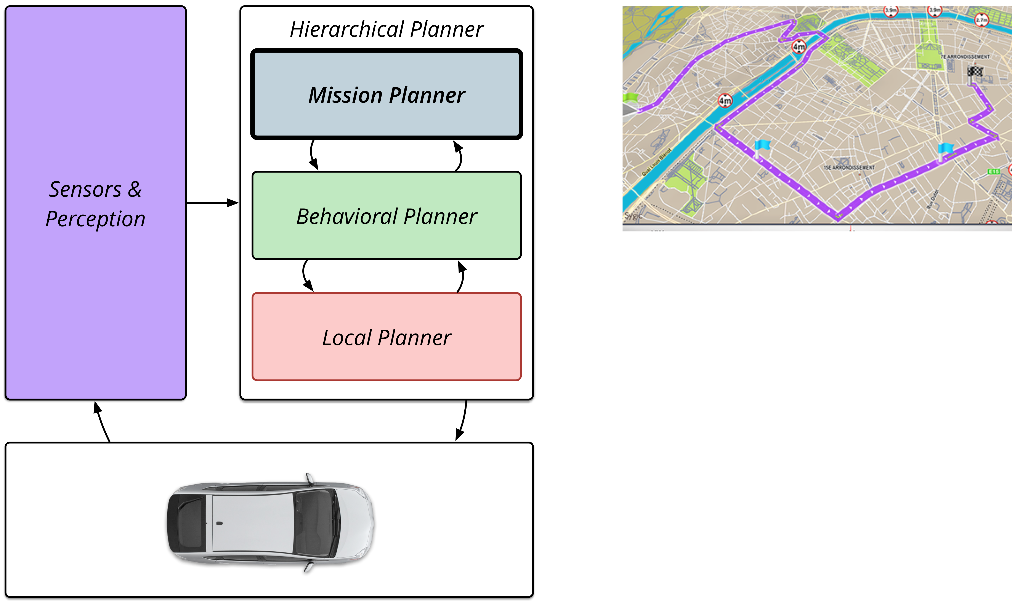
Basic Architecture
The mission planner determines the series of road network links that the AV will follow in order to accomplish the mobility goals of the vehicle’s occupants. Such information defines the road geometry, reference trajectories and waypoints that the behavioral planner will reason about.

Slide 11
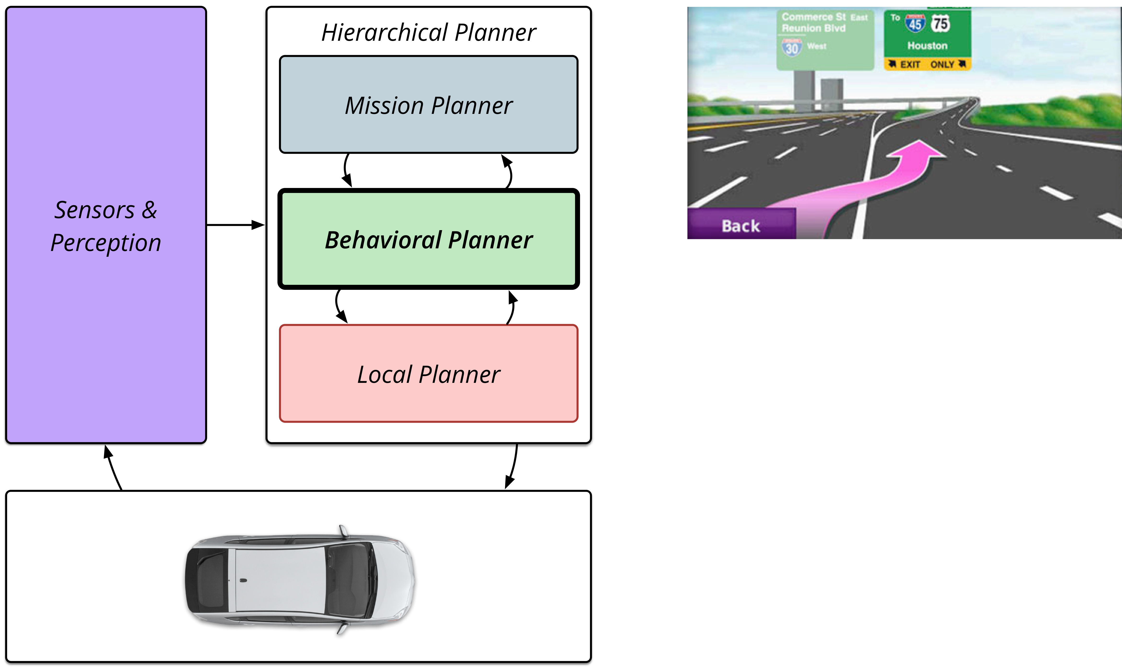
Basic Architecture
The behavioral planner makes local decisions regarding the short term goals of the vehicle. For example the behavioral planner may initiate a lane change based on the need to exit the highway. Alternatively the behavioral planner may reason about a variety of traffic situations such as judging that the car switch to traffic jam mode.

Slide 12
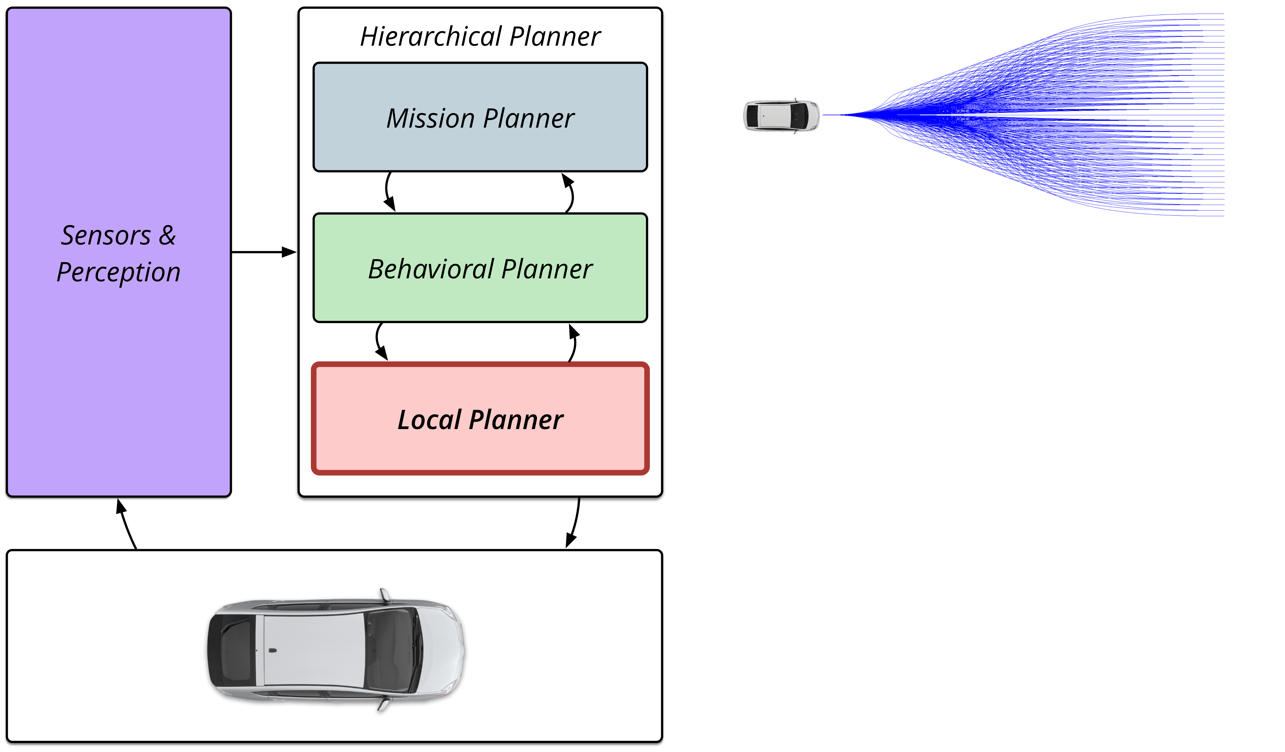
Basic Architecture
The local planner is responsible for trajectory generation and evaluation. Based on the goal selection provided by the behavioral planner, the local planner may use a variety of heuristic or optimal control techniques to compute dynamically and kinematicaly feasible trajectories.

Slide 13
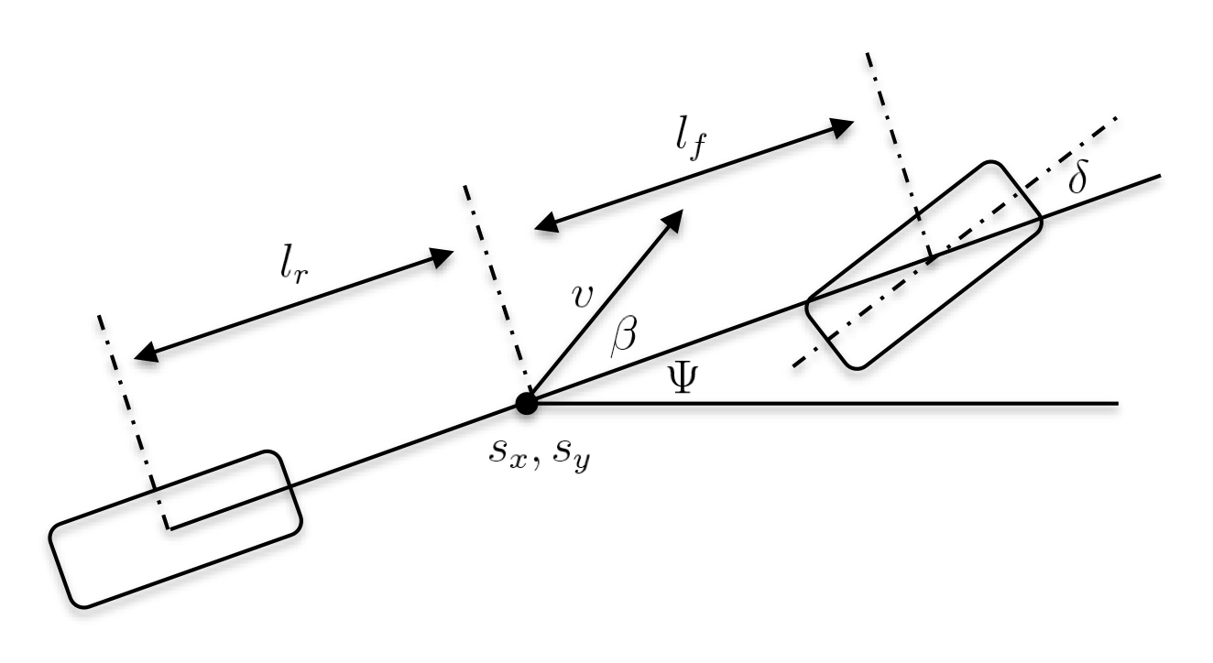
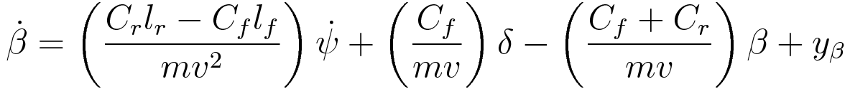
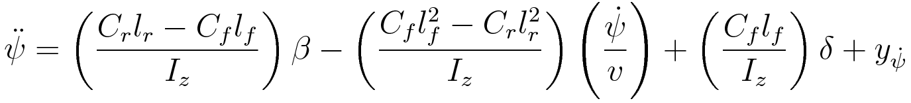
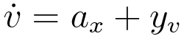
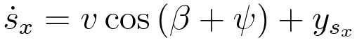
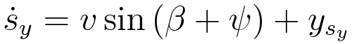
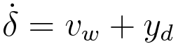
Vehicle Model
The bicycle model to is used as the intermediate representation (IR) because it supports verification of low level trajectory trackers and analysis with respect to first order logic necessary for formal verification.
Model captures the effect of steering input and longitudinal acceleration on the vehicle’s trajectory.

Slide 14
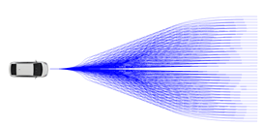
Trajectory Generation
(Local planner generates multiple trajectories every 100ms)
(Local planner choose one best trajectory every 100ms)
Trajectory 1
Local Planner
(C++ Implementation)
Trajectory 2
Trajectory 3
Trajectory k
Trajectory n
Trajectory k
Choosing a Single trajectory
Every 100ms by Cost Function
System
Start
Trajectory 1
Trajectory 2
Trajectory 3
Trajectory 4
Trajectory 5
Trajectory 6
Trajectory 7
Trajectory 8
400ms
600ms
700ms
Time

Slide 15
Trajectory Generation
Math and algorithms?

Slide 16
Development of Hybrid Systems Framework

Slide 17
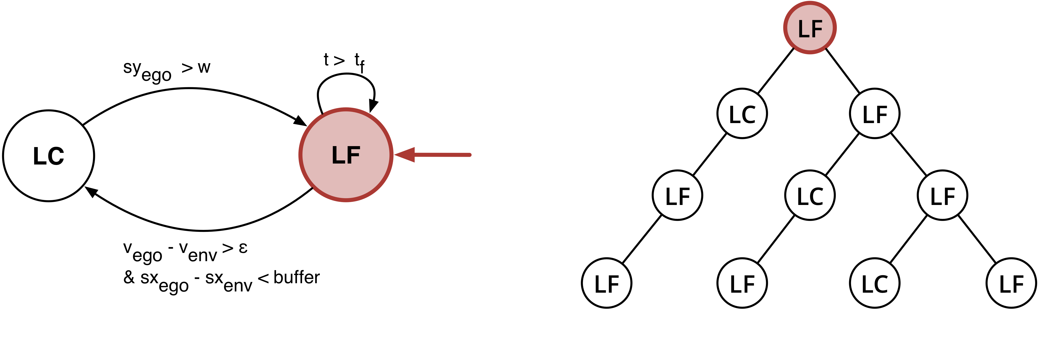
Behavior Controller
Start in the Lane Following mode.

Slide 18
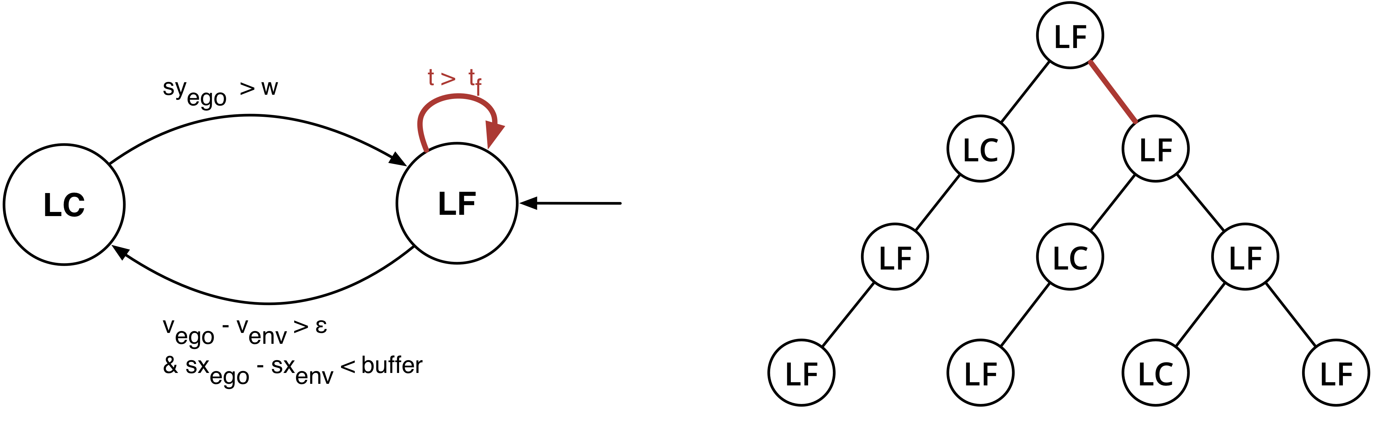
Behavior Controller
If the current time is greater than the schedule period update the reference trajectory…

Slide 19
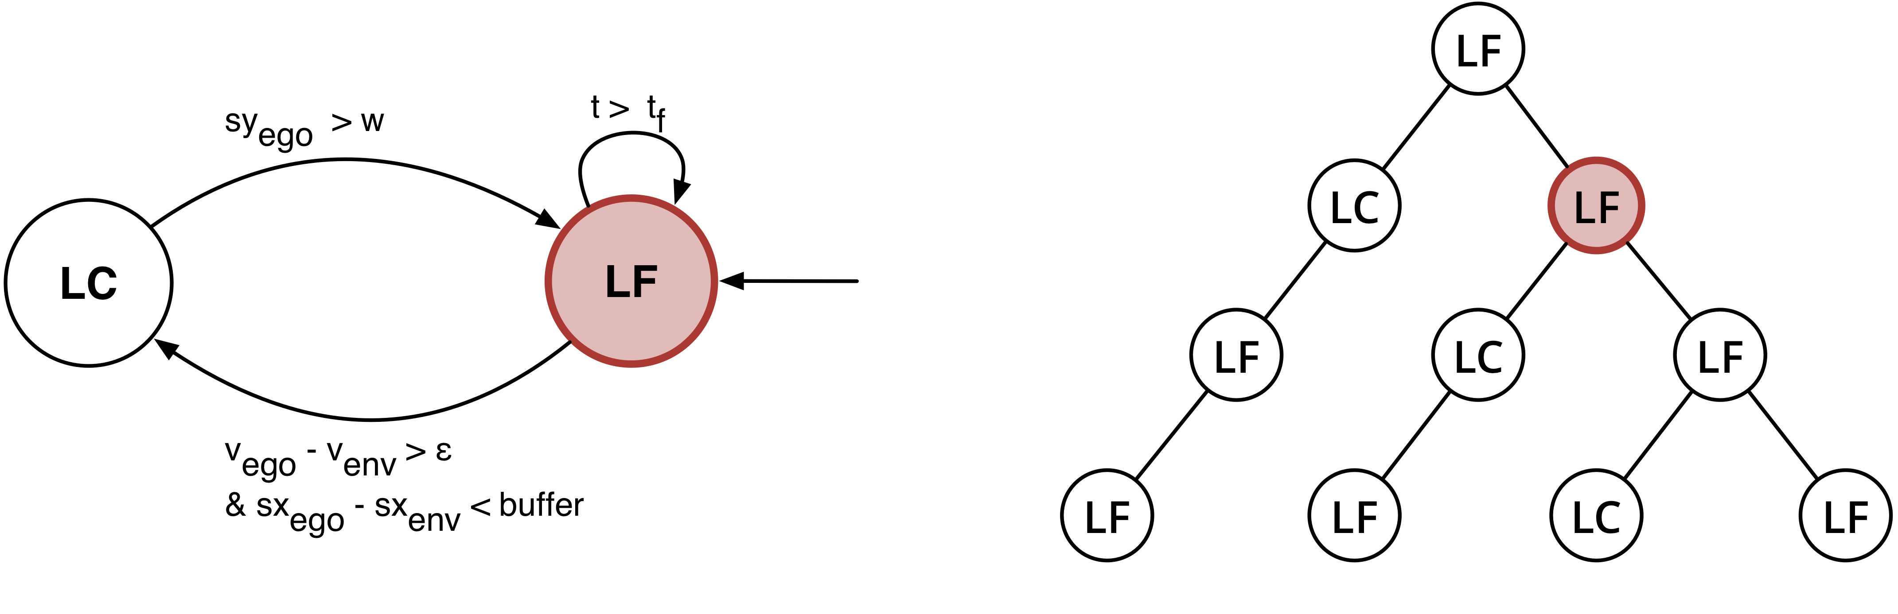
Behavior Controller
Continue in the Lane Following mode following updated reference trajectory.

Slide 20
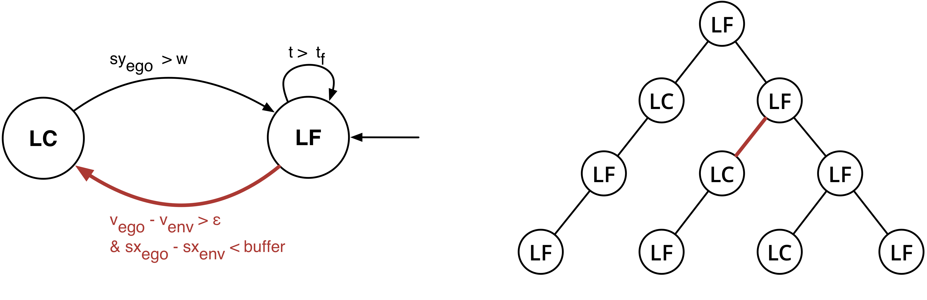
Behavior Controller
If the ego-vehicle is within the buffer and the difference in velocities is big enough transition.

Slide 21
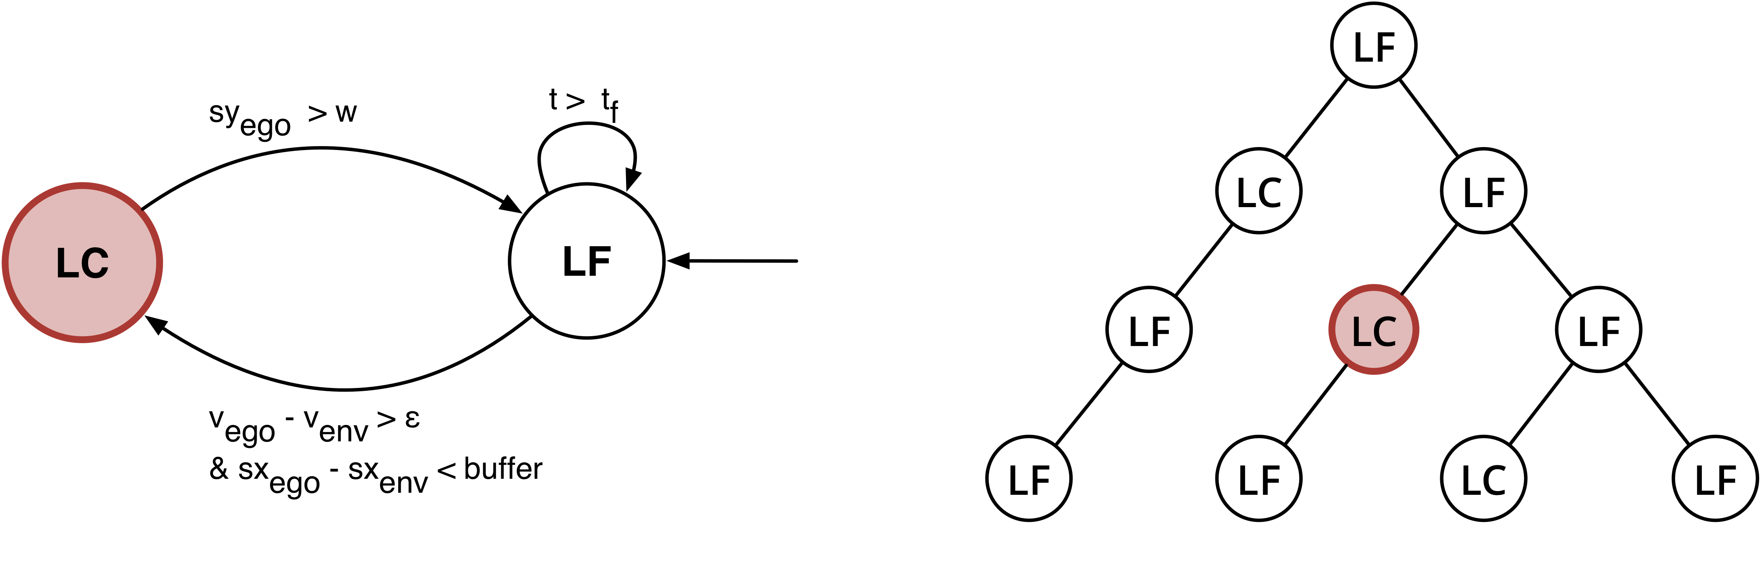
Behavior Controller
Enter Lane Change mode and follow new reference trajectory.

Slide 22
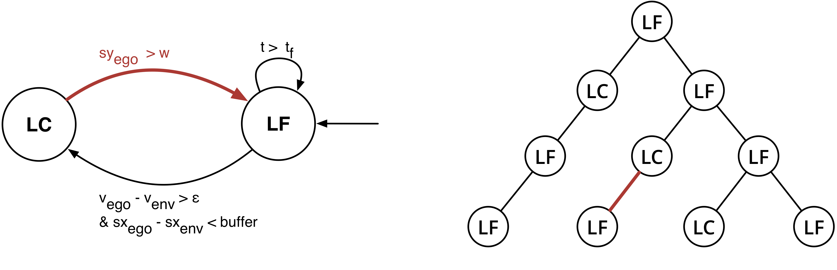
Behavior Controller
If the ego-vehicle has entered new lane update reference trajectory and execute transition.

Slide 23
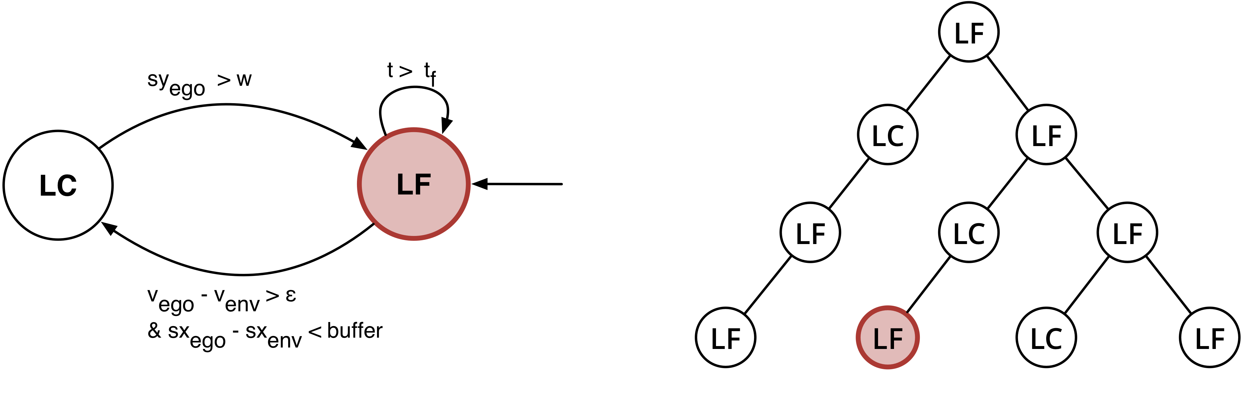
Behavior Controller
Continue in the Lane Following mode following updated reference trajectory.

Slide 24
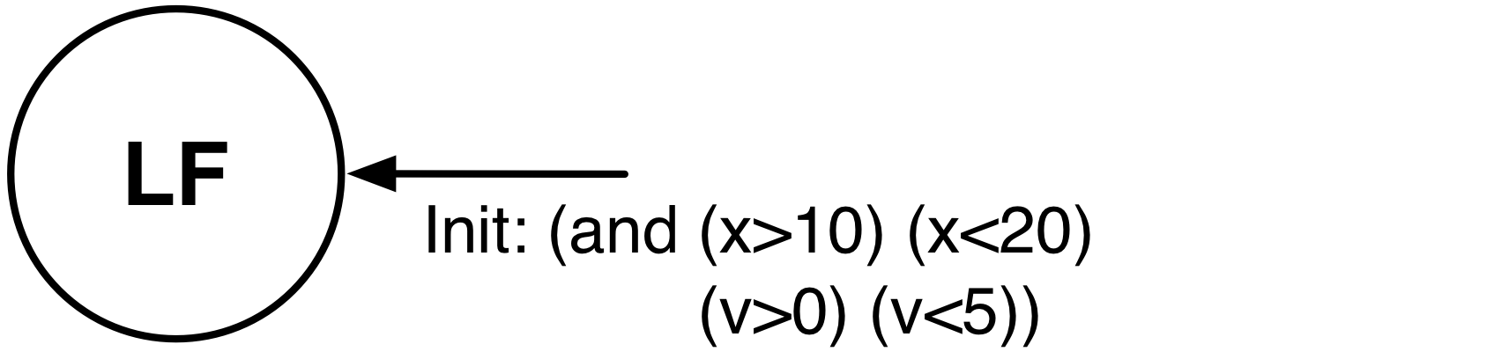
Other Drivers
For this study we show an extremely simple model of the other cars in the environment
We do not know the control inputs for the other vehicles so here it is fruitless to include a more expressive dynamical model
We only care about the path which the other vehicle will take
In this case we allow non-determinism in the initial estimate of the vehicles velocity.
Real multiobject tracking perception algorithms assume constant velocity between each position update, thus this is not a bad model.
We will show later how more complexity can be added to the non-deterministic behavior of the other agents in the environment by taking unknown control inputs as differential inclusions.

Slide 25
Scenario 1

Slide 26
Lane Change

Slide 27
Specification

Slide 28
Verification Algorithm

Slide 29
dReach Verification Instance
// Dynamics
{
// Lane change motion primitive
mode 1;
invt:
// X position must be greater than or equal to 0
(sx>=0);
// Velocity must be greater than or equal to 0
(v>=0);
flow:
/* TARGET VEHICLE */
/* Plant equations */
d/dt[tau]=1; // Time
// Compute rate of change of the slip angle
d/dt[Beta]=((cl/(m*v*v))-1.0)*Psi_dot + Cf*delta/(m*v) - (Cf+Cr)*Beta/(m*v);
d/dt[Psi]=Psi_dot; // Rate of change of the heading angle is equal to yaw rate
// Rate of change of yaw rate
d/dt[Psi_dot]=(cl*Beta/Iz) - ((lf*lf*Cf+lr*lr*Cr)/Iz)*(Psi_dot/v) + (lf*Cf)*delta/Iz;
d/dt[v]=ax; // Longitudinal acceleration
d/dt[sx]=v*cos(Beta+Psi); // X component of velocity
d/dt[sy]=v*sin(Beta+Psi); // Y component of velocity
d/dt[delta]=vw; // Rate of change of front wheel angle.
/*Trajectory and Tracking Equations*/
d/dt[kappa_d] = b*v_d + 2*c*v_d*v_d*tau + 3*e*v_d*v_d*v_d*tau*tau ;
d/dt[Psi_d] = v_d*kappa_d;
d/dt[sx_d] = v_d*cos(Psi_d);
d/dt[sy_d] = v_d*sin(Psi_d);
d/dt[Psi_dot_d] = v_d*(b*v_d + 2*c*v_d*v_d*tau + 3*e*v_d*v_d*v_d*tau*tau);
// Other Vehicle
d/dt[sx_env]=0.0;
jump:
}
init:
@1 (and (sx>=0) (sx<=0.5) (sy>=0) (sy<=0.1) (v>=10.8) (v<=11.1) (sx_d=0) (sy_d=0)
(Psi>=0) (Psi<=0.01) (Psi_dot=0) (Beta=0) (delta=0) (tau=0)
(Psi_d=0) (Psi_dot_d=0)
(sx_env=15) (kappa_d=0));
goal:
@1 (or (and (sy<w) (tau>2) (tau<3)) (and (sy<w) (sx>sx_env)));
An example dReach file that is automatically converted from one trajectory generated from the local planner
//Trajectory
#define s (22.681867) #define kappa_0 (0.000000) #define kappa_1 (0.033194)
#define kappa_2 (-0.033194) #define kappa_3 (0.000000)
// Constants
#define m 2273.0 #define Iz 4423.0 #define Cf 108000.0 #define Cr 108000.0
#define lf 1.292 #define lr 1.515 #define k1 2.0 #define k2 12.0 #define k3 4.0
#define k4 2.0 #define k5 1.0 #define k6 10.0
// Scenario parameters
#define w 3.7 // Width of road
#define v_d 11.11 // Desired velocity
#define a_env 0.0 // Acceleration of environmental vehicle.
// Helpers to clean up equations...
#define cl (Cr*lr-Cf*lf)
// Tracking controller inputs
// Rate of change of front wheel angle
#define vw k1*(cos(Psi_d)*(sy_d - sy) - sin(Psi_d)*(sx_d - sx)) +k2*(Psi_d - Psi) +k3*(Psi_dot_d - Psi_dot) -k4*(delta)
// Longitudinal acceleration
#define ax k5*(cos(Psi_d)*(sx_d - sx) + sin(Psi_d)*(sy_d - sy)) +k6*(v_d-v)
// Cubic spline inputs
#define a (kappa_0)
#define b ((-0.50)*(-2*kappa_3 + 11*kappa_0 - 18*kappa_1 + 9*kappa_2)/s)
#define c ((4.50)*(-kappa_3 + 2*kappa_0 - 5*kappa_1 +4*kappa_2)/(s*s))
#define e ((-4.50)*(-kappa_3 + kappa_0 - 3*kappa_1 + 3*kappa_2)/(s*s*s))
// Bounds on variables
[0,3.1] tau; [-2,2.03] Beta; [-2,2.04] Psi; [-2,2.05] Psi_dot;
[6,12] v; [0,50] sx; [0,10] sy; [-2, 2.04] delta; [0, 3.1] time;
[-2,2.06] kappa_d; [-2,2.07] Psi_d; [0,50] sx_d; [0,10] sy_d; [-2,2.08] Psi_dot_d;
[9, 50] sx_env;

Slide 30
Lane Change
Symbol | Note | Old Assignment | New Assignment
w | Lane Width | - | 3.7m
ε | Threshold of the relative speed | - | 1 m/s
Buffer | Distance from the ahead vehicle | - | 15 m
tf | Max timestep to generate the trajectories | - | 3.0 s
V | Velocity of Ego Vehicle | - | [10.8, 11.1]
Sx | Position of Ego Vehicle, X | - | [0.0, 0.5]
Sy | Position of Ego Vehicle, Y | - | [0.0, 0.1]
Φ | Orientation of Ego Vehicle, rad | - | [0.0, 0.1]
Scenario
The vehicle ahead suddenly stops during lane following
Verification Result: SAT (Unsafe)
(i.e.) the vehicle may crash the ahead vehicle)
Analysis (Based on the counter example)
Buffer (15m) is too small to change the lane
Initial position of the vehicle is heading slightly toward right before starting lane changing
The dotted line shows the intended trajectory, the solid line shows the actual trajectory
Error due to poor state estimation

Slide 31
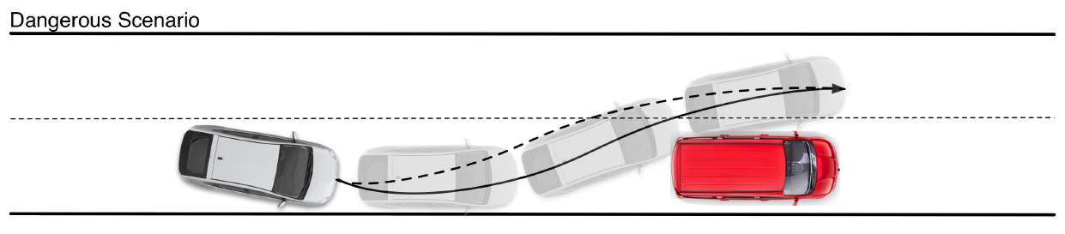
Lane Change: Part 2
Symbol | Note | Old Assignment | New Assignment
w | Lane Width | 3.7m | 3.7m
ε | Threshold of the relative speed | 1 m/s | 1 m/s
Buffer | Distance from the ahead vehicle | 15 m | 20 m
tf | Max timestep to generate the trajectories | 3.0 s | 3.0 s
V | Velocity of Ego Vehicle | [10.8, 11.1] | [10.9, 11]
Sx | Position of Ego Vehicle, X | [0.0, 0.5] | [0.0, 0.5]
Sy | Position of Ego Vehicle, Y | [0.0, 0.1] | [0.0, 0.05]
Φ | Orientation of Ego Vehicle, rad | [0.0, 0.1] | [0.0, 0.1]

Slide 32
Lane Change: Part 3
Symbol | Note | Old Assignment | New Assignment
w | Lane Width | 3.7m | 3.7m
ε | Threshold of the relative speed | 1 m/s | 1 m/s
Buffer | Distance from the ahead vehicle | 15 m | 20 m
tf | Max timestep to generate the trajectories | 3.0 s | 3.0 s
V | Velocity of Ego Vehicle | [10.8, 11.1] | [10.9, 11]
Sx | Position of Ego Vehicle, X | [0.0, 0.5] | [0.0, 0.5]
Sy | Position of Ego Vehicle, Y | [0.0, 0.1] | [0.0, 0.05]
Φ | Orientation of Ego Vehicle, rad | [0.0, 0.1] | [0.0, 0.2]

Slide 33
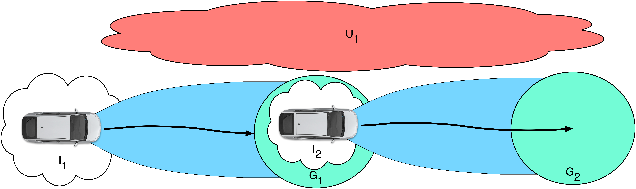
Results: Composition of Trajectories
The ego-vehicle starts in I₁, I₁ does not intersect U₁ unless the verification problem is trivially SAT.
If verification instance 1 returns UNSAT, then X, the ego vehicle’s state, never intersects U₁ and the ego-vehicle finishes the run within G₁
Verification instance 2 must begin within I₂ , I₂ is a subset of G₁. Thus, I₂ does not intersect U₁.
If verification instance 2 returns UNSAT, then X, the ego vehicle’s state, never intersects U₁ and the ego-vehicle finishes the run within G₂
Thus, the ego vehicle never intersects the unsafe region U₁ and we show that the composition of two UNSAT bounded time verification instances must imply that the ego vehicle can never intersect U₁ over the combined horizon.

Slide 34
Results: Verification Instances are Independent

Slide 35
Results: Infinite Time Property

Slide 36
Runtime and Complexity

Slide 37
Modeling Part 2

Slide 38
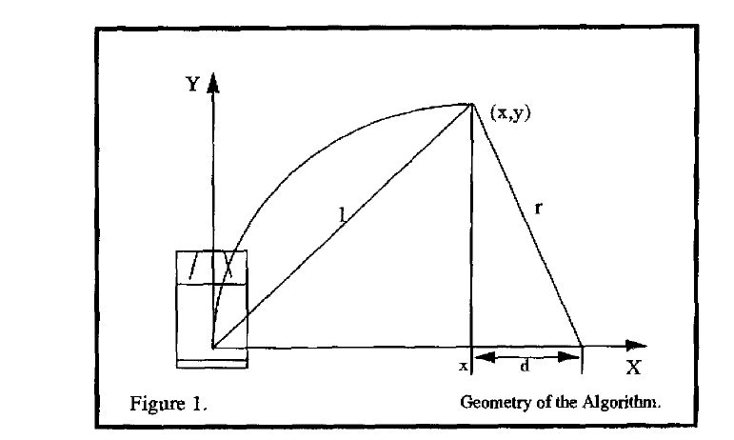
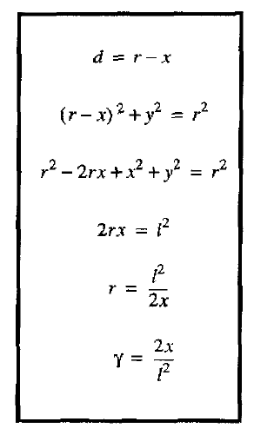
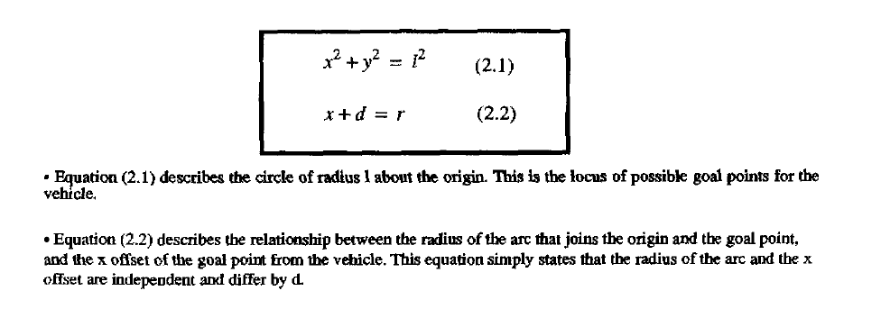
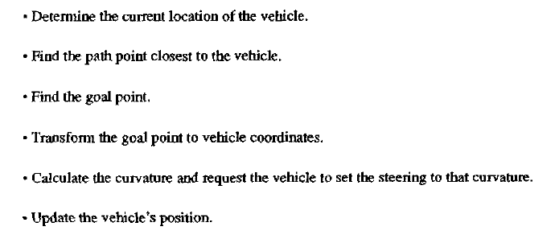
Pure Pursuit: Algorithm

Slide 39
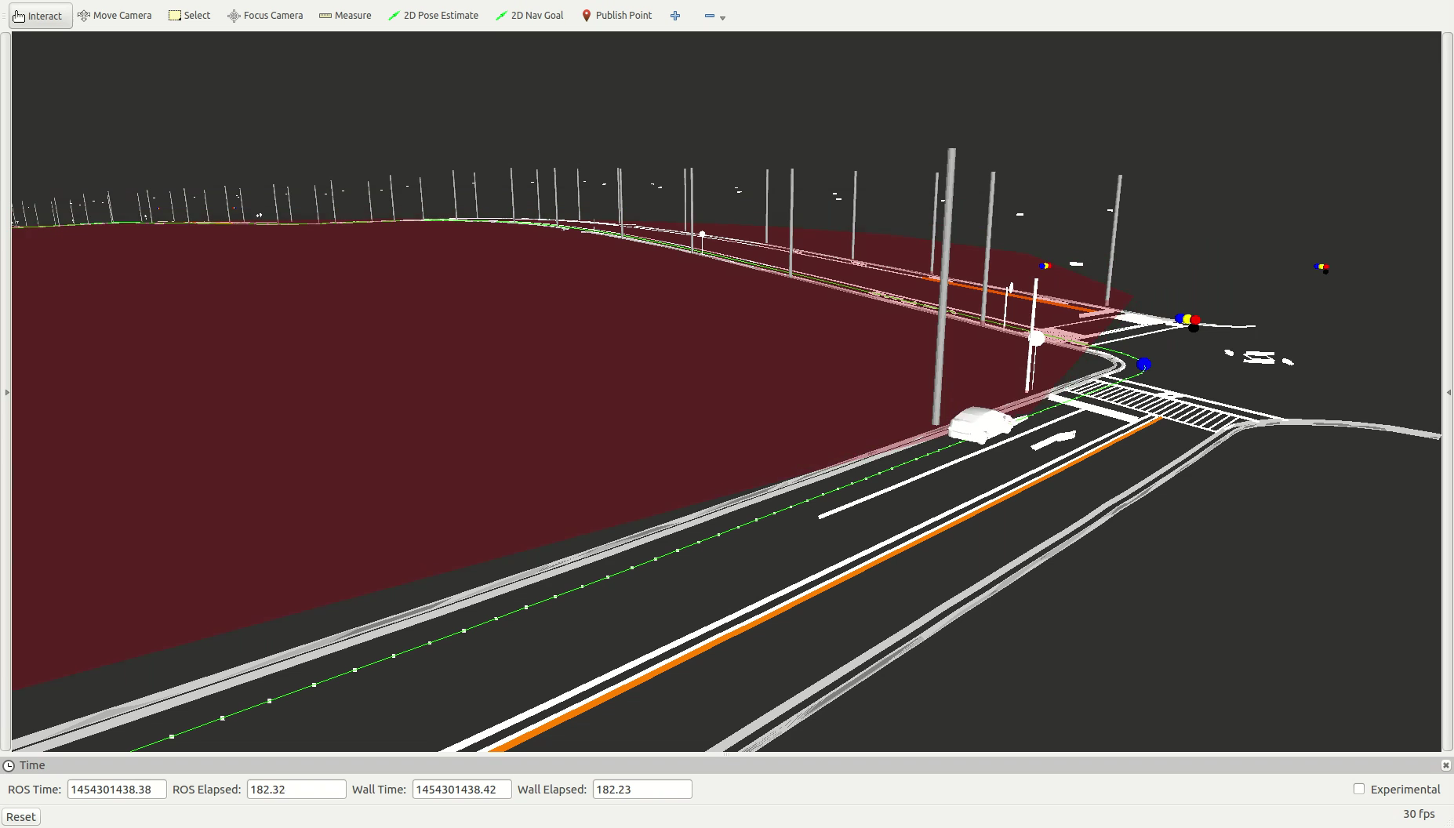
Pure Pursuit

Slide 40
Sources of Non-Determinism
Note subtle difference in this model of the vehicle.
Every ODE now contains a differential inclusion term
For example y_{b} describes an interval on which an error term may realize a value.

Slide 41
Differential Inclusions
[0, 20] x;
[-9.8] g;
[-100, 100] v;
[0, 10] time;
[-1, 1] noise [2.0];
{ mode 1;
invt:
(v <= 0);
(x >= 0);
flow:
d/dt[x] = v + noise;
d/dt[v] = g + noise;
d/dt[noise] = 0;
jump:
(x = 0) ==> @2 (and (x' = x) (v' = (0 - v)));
}
In order to model uncertainty we can add noise terms to the dynamics of various agents.
For example a priori environmental agents may accelerate at any rate within a specified interval.
Furthermore, the measurement of certain state variables of the ego vehicle may be subject to sensor noise.
If we are to design robust robotic systems it is desirable to verify the design under the presumption that any of these conditions may prevail at any time.

Slide 42
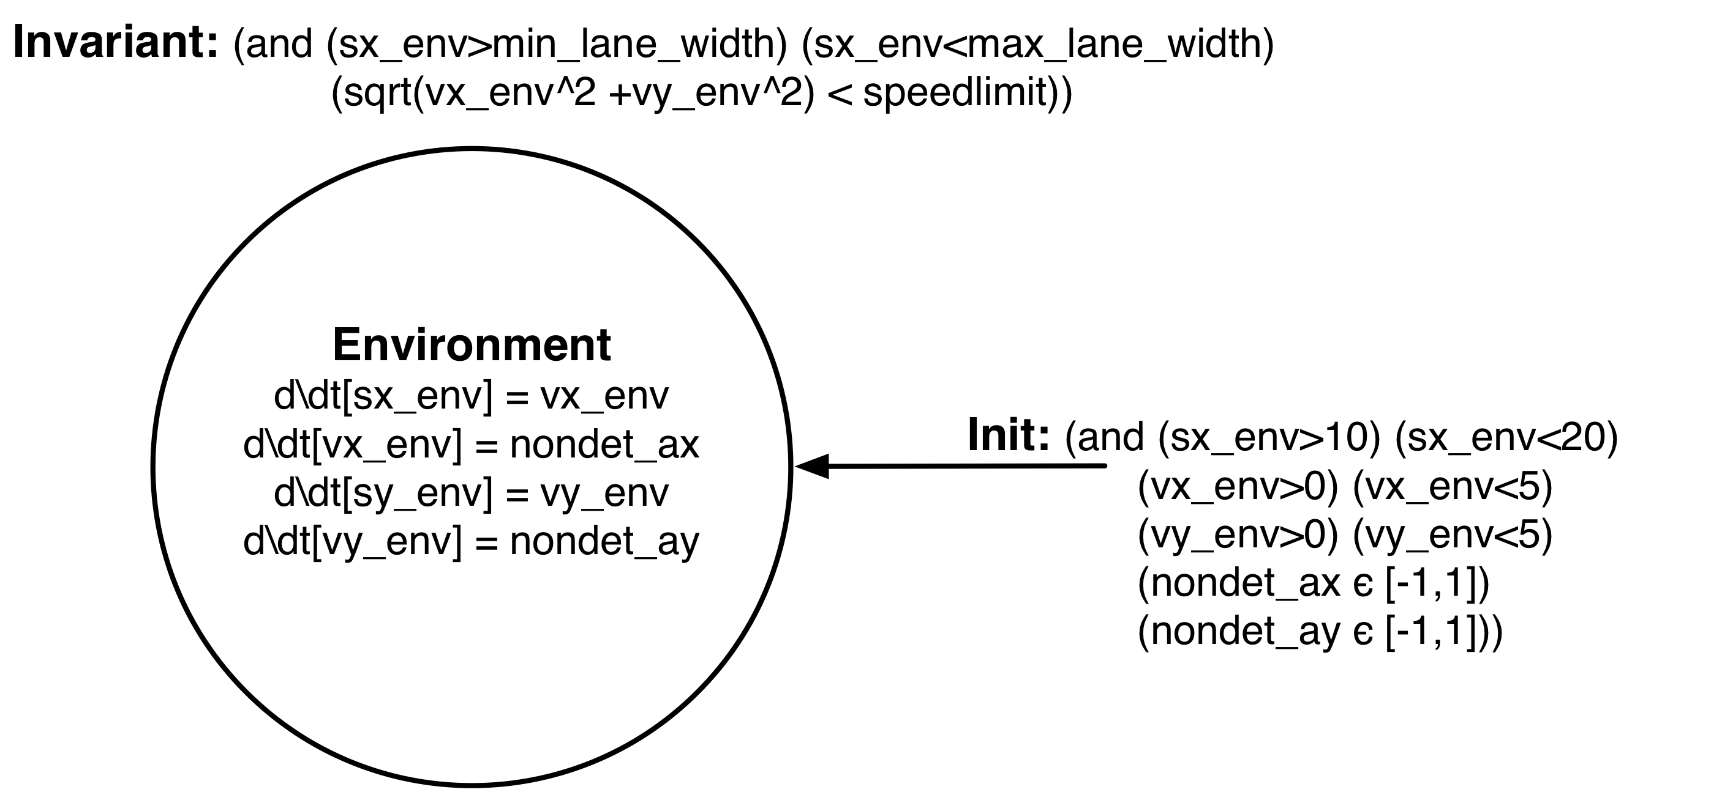
Other Drivers
We now show how adding differential inclusions can increase the realism of the environment model.
We still do not know the control inputs for the other vehicles so here it is fruitless to include a more expressive dynamical model.
Instead we retain the kinematics and bound control inputs within an interval.
This is realistic as there is a limit to the control effort (ie engine power).
In this case we allow non-determinism in the initial estimate of the vehicles velocity and in the acceleration input at every time step.
Real vehicles may not drive at a constant velocity.
We will show later how more complexity can be added to the non-deterministic behavior of the other agents in the environment by adding discrete modes of operation.

Slide 43
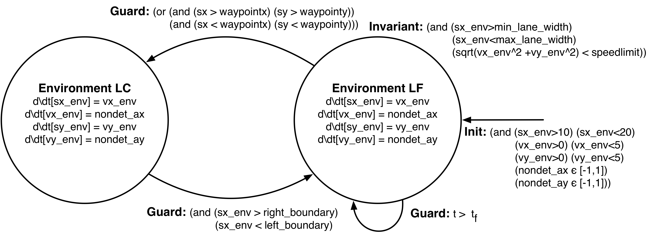
Other Drivers
We now show how adding discrete transitions to new modes can increase the expressivity of the environment model.
In the development of ADAS systems we may be particularly interested a subset of environment actions.
For example we may be interested in the performance of an automated lane change feature in the presence of an environment that is capable of instantiating a lane change while the ADAS system is operating
Using this model the engineer will have finer grained control over the environment and more expressive counterexamples will be returned.
Rather than just returning the state of the environmental vehicle, the discrete mode it is operating in will also be included in the counterexample
Furthermore such a model will be able to prevent certain degenerate behavior through correctly set guards.

Slide 44
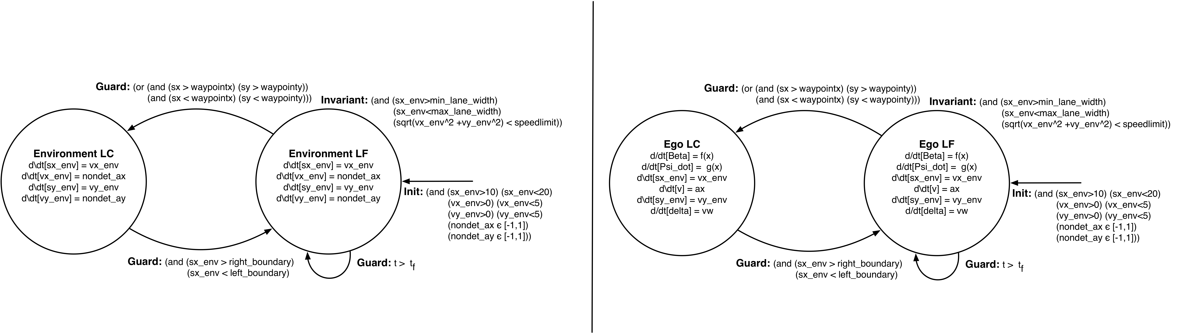
Composition of Environment and Ego Vehicle Automatons

Slide 45
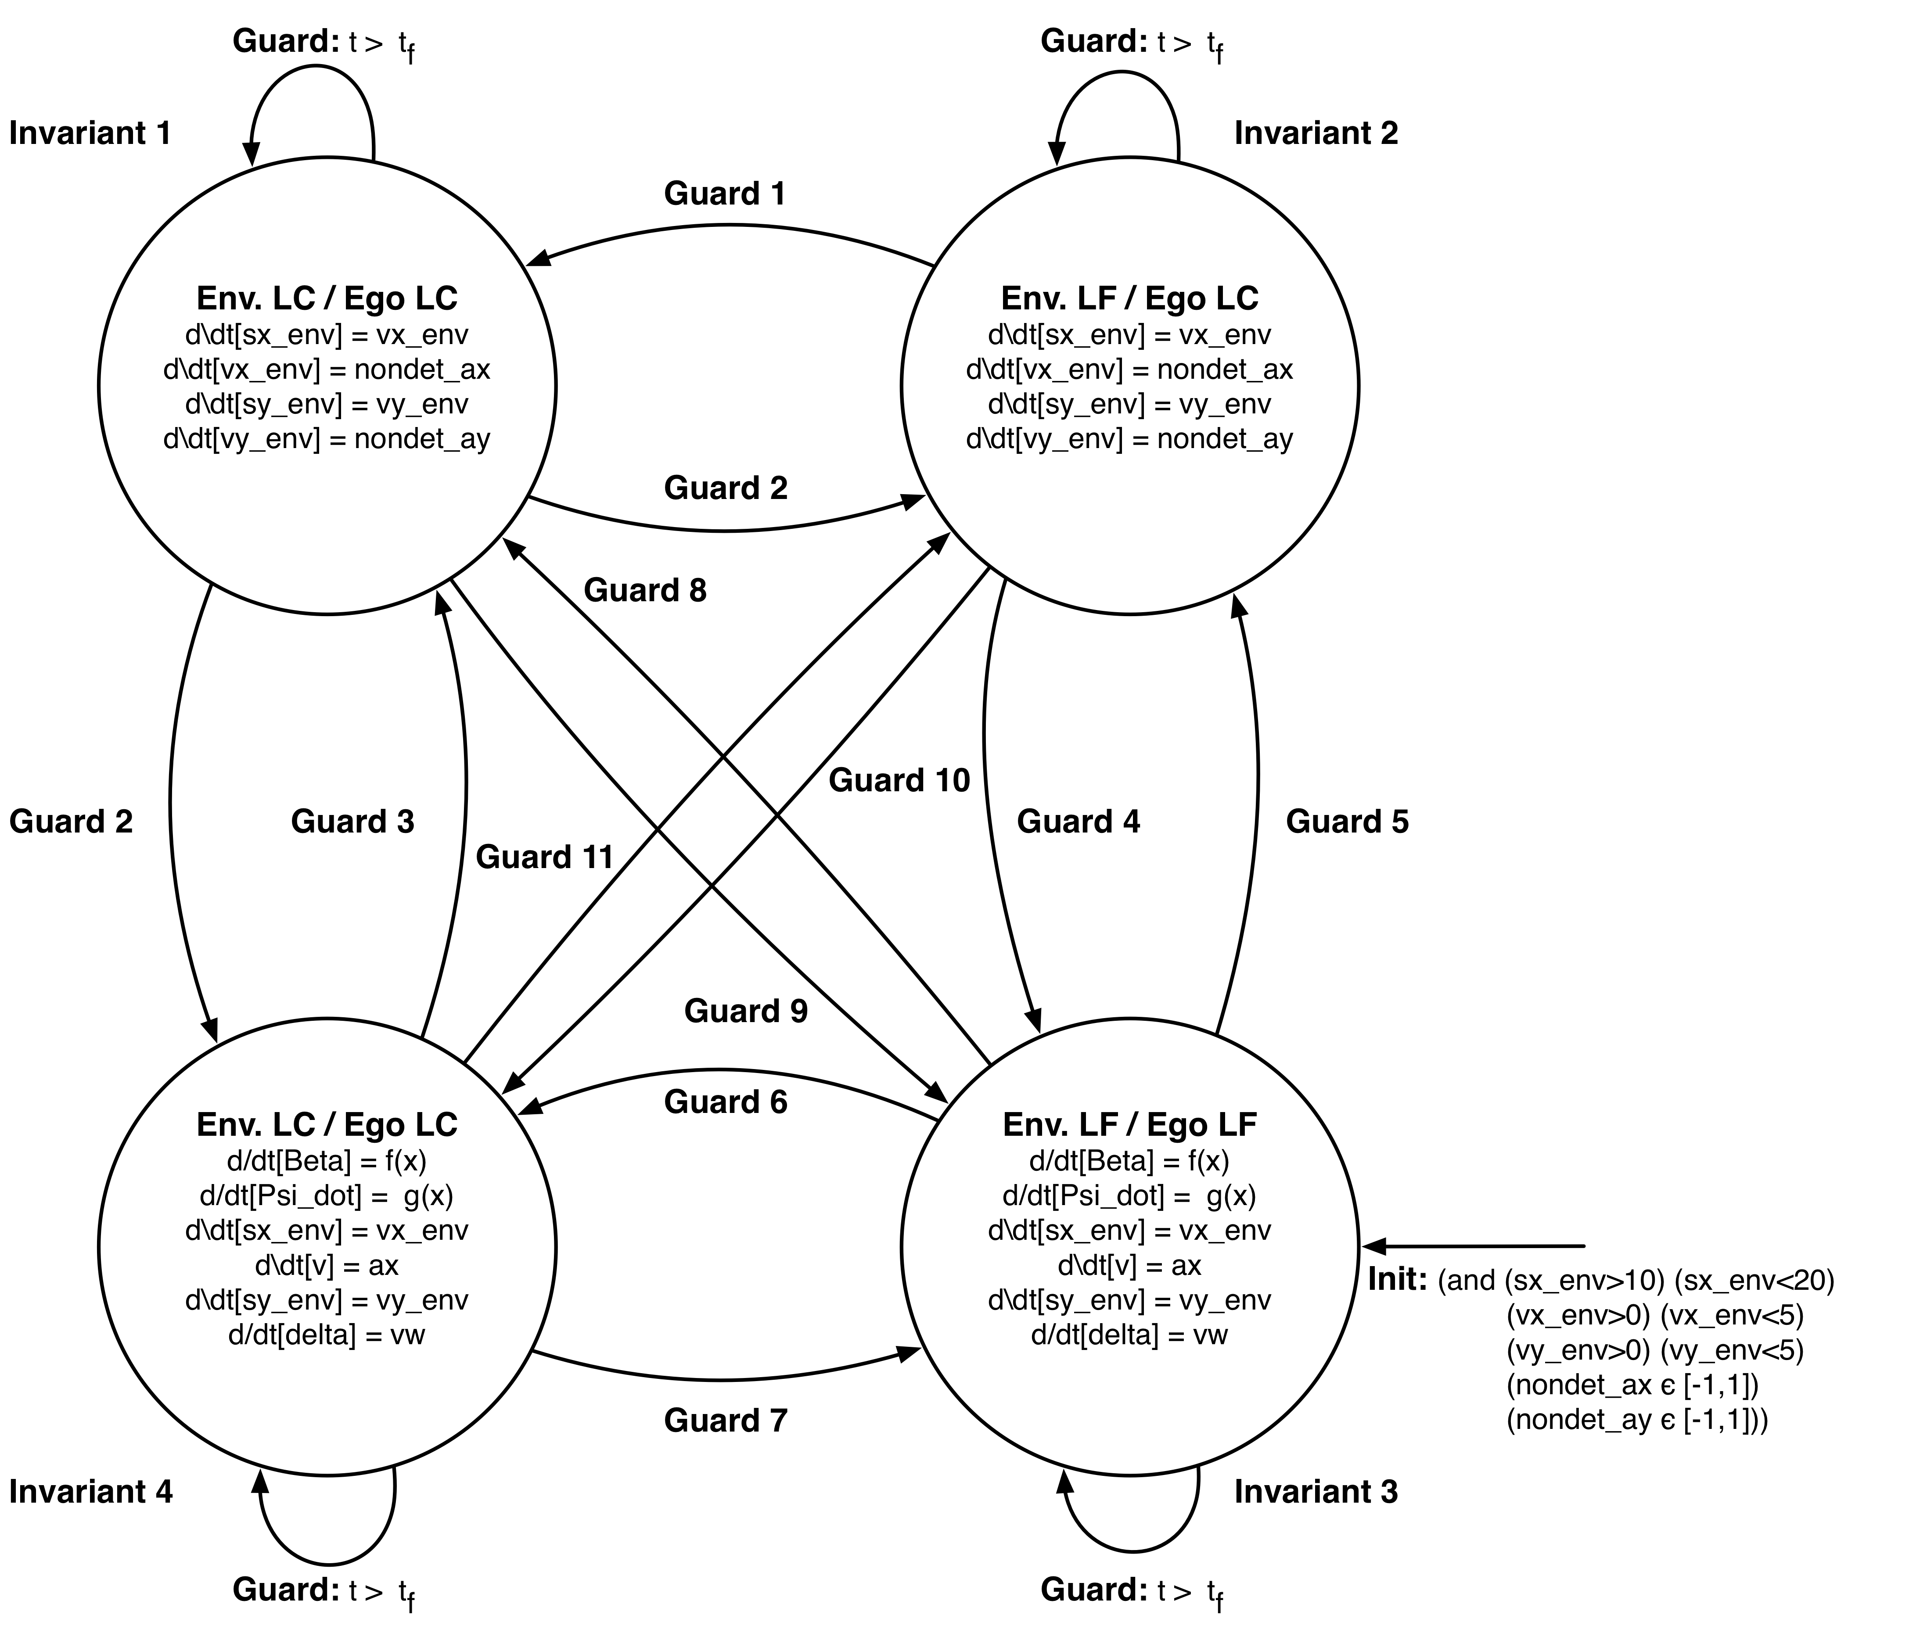
Composition of Environment and Ego Vehicle Automatons

Slide 46
Scenario 2

Slide 47
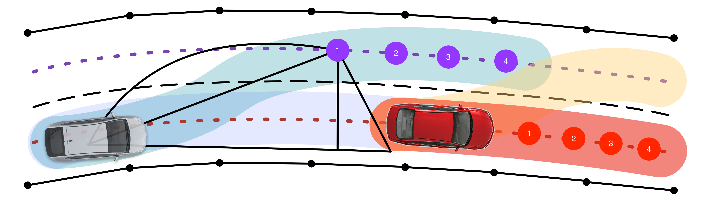
Simple Lane Change

Slide 48
Specification

Slide 49
Variations

Slide 50
Complexity and Results

Slide 51
F1/10

Slide 52
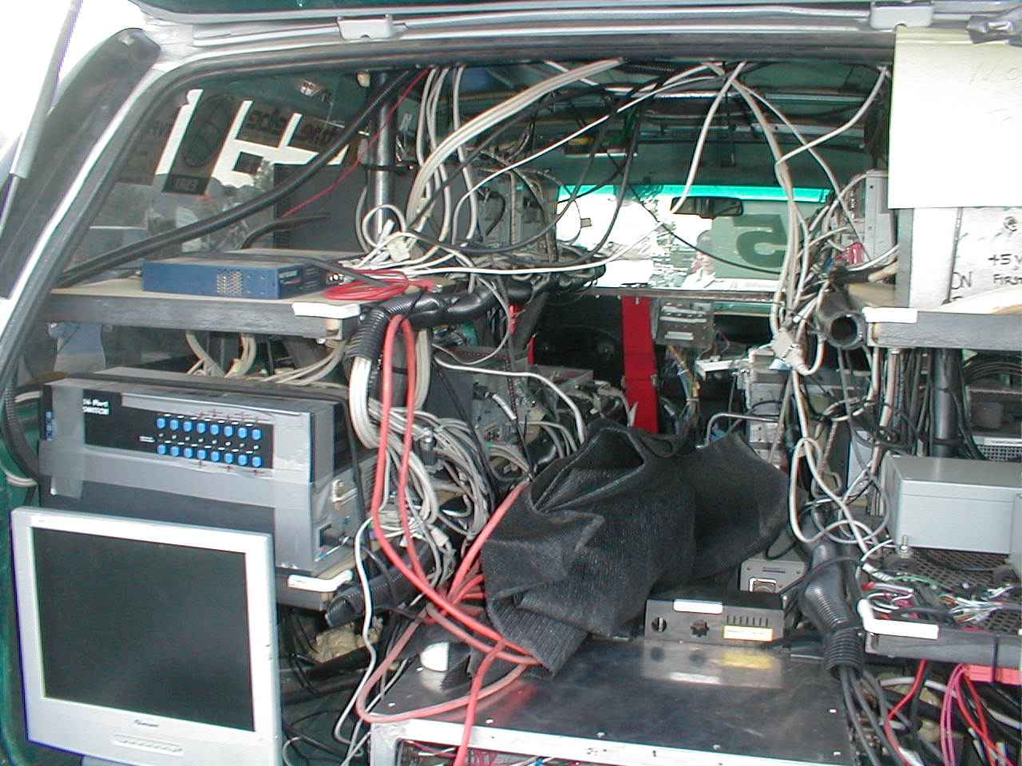
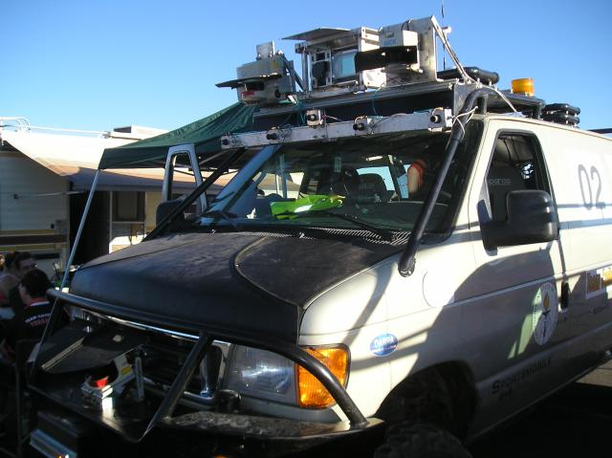
Agile AV Platform
In 2008 AV prototypes, were ad-hoc, complex, and expensive…

Slide 53
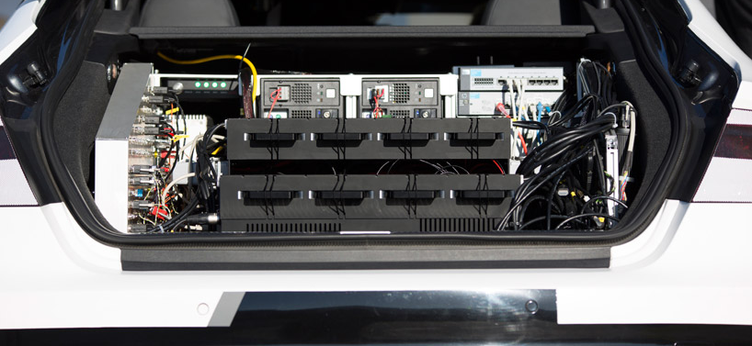
Agile AV Platform
Today industrial grade prototypes have gotten better, but platforms are still inaccessible and dangerous…

Slide 54
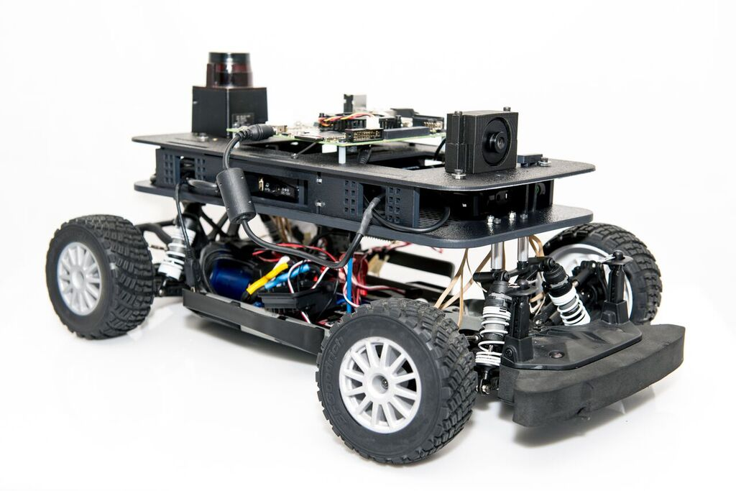
Agile AV Platform
NVIDIA Jetson TK1
LIDAR
PointGrey Camera
TRAXXAS RC Car

Slide 55
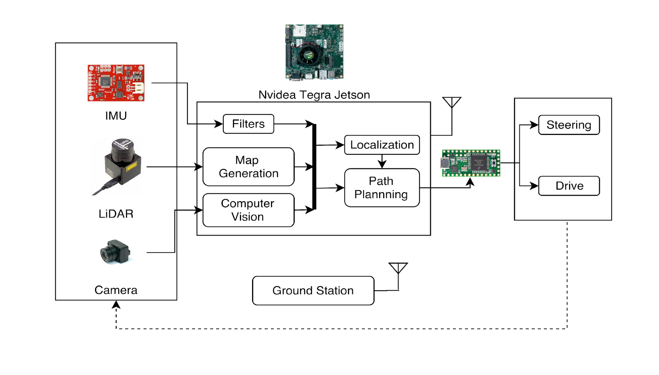
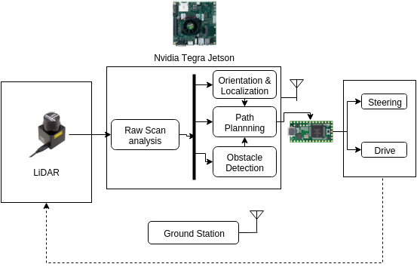
Agile AV Platform

Slide 56
Agile AV Platform

Slide 57
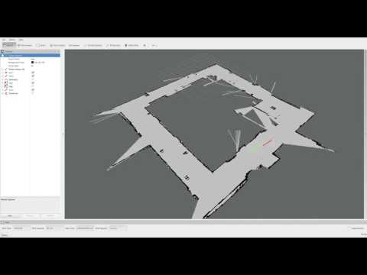
Agile AV Platform

Slide 58
Demo

Slide 59
APEX Tool

Slide 60
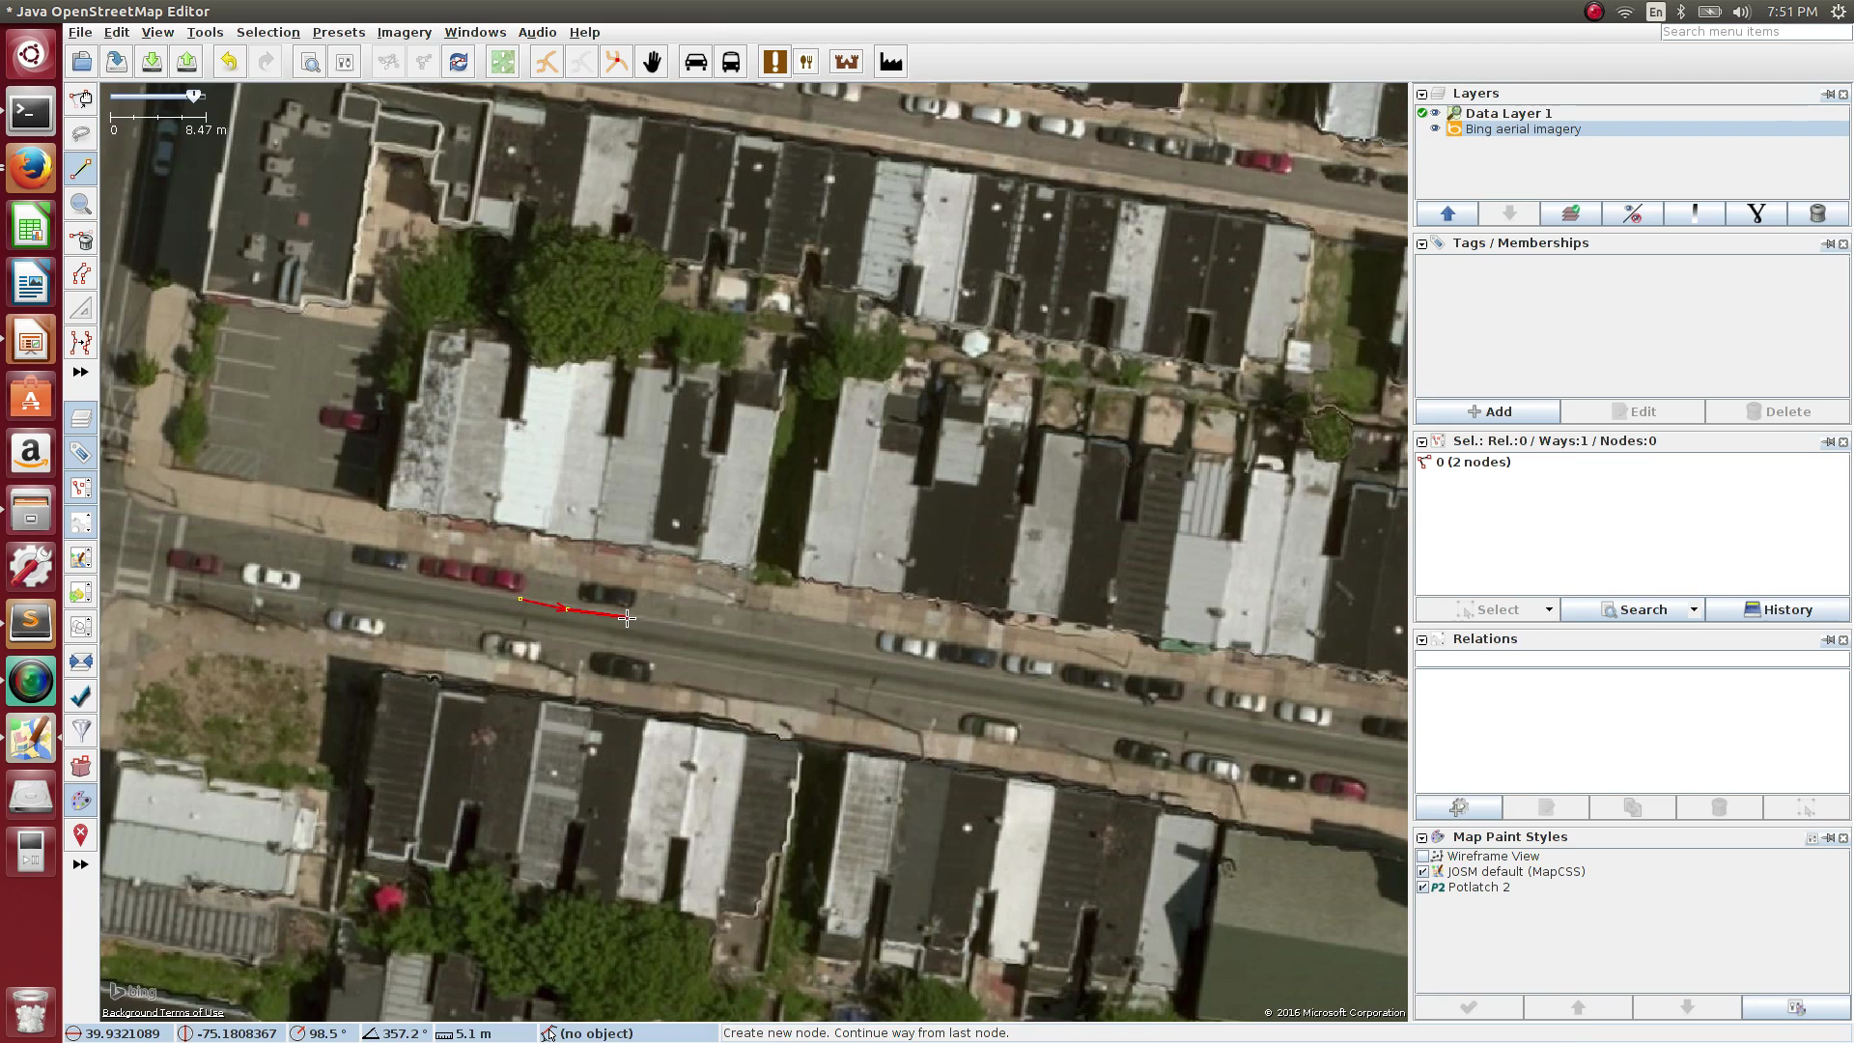
Map Manipulation

Slide 61

Reference Trajectory Generation

Slide 62
Traffic Control

Slide 63
Agents

Slide 64
Behavior Specification

Slide 65
File Generation

Slide 66
Counterexamples

Slide 67
Interfacing AV Infrastructure
Wrapper for trajectory generation software so that it may be used with Unity.
Link:
How to:

Slide 68
Next Steps

Slide 69
Next Steps: Proactive Driver Assistance
Collaboration with Nagoya to verify REAL behavioral control algorithm being tested on REAL vehicles
Can provide insight into workflow…

Slide 70
Next Steps: Proactive Driver Assistance

Slide 71

Next Steps: Proactive Driver Assistance

Slide 72
Traffic Generation
Use GrooveNet infrastructure?

Slide 73
Summary

